Slide 1

Perfecting Your Streaming Skills with Spark and Real World IoT Data
Bob Wakefield
Principal
bob@MassStreet.net
Twitter: @BobLovesData

Slide 2
Bob’s Background
IT professional 16 years
Currently working as a Data Engineer
Education
BS Business Admin (MIS) from KState
MBA (finance concentration) from KU
Coursework in Mathematics at Washburn
Graduate certificate Data Science from Rockhurst
Addicted to everything data

Slide 3
Follow Me!
Personal Twitter: @BobLovesData
Company Twitter: @MassStreet
Blog: DataDrivenPerspectives.com
Website: www.MassStreet.net
Facebook: @MassStreetAnalyticsLLC

Slide 4
KC Learn Big Data Objectives
Educate people about what you can do with all the new technology surrounding data.
Grow the big data career field.
Teach skills not products

Slide 5
ACM Kansas City
We’re looking for a speaker willing to talk in deep detail about data engineering challenges their organization is experiencing.

Slide 6
This Evening’s Learning Objectives
Learn how to practice your IoT skills with real world IoT data.

Slide 7
Motivations For This Evenings Discussion
Getting ready for the opportunities that IoT presents.
Tired of working with Sandboxes
Tired of playing with human generated data

Slide 8
Disclaimer
Tonight’s presentation is based on a personal hack-a-thon.

Slide 9
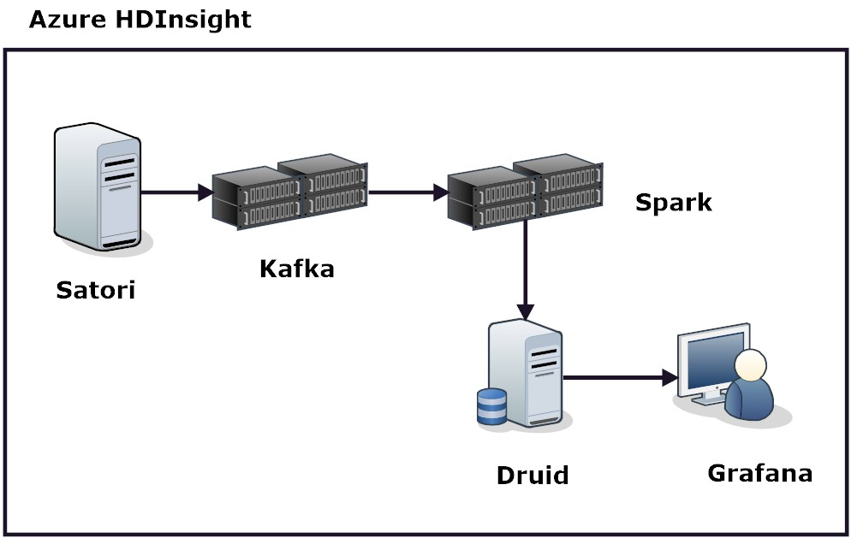
The Original Plan

Slide 10
The Original Plan
Azure HDInsight
Push button cluster
Kafka
Distributed pub/sub messaging system
Spark
Stream Processing framework
Druid
Opensource OLAP NoSQL real time database
Grafana
IoT Dashboard

Slide 11
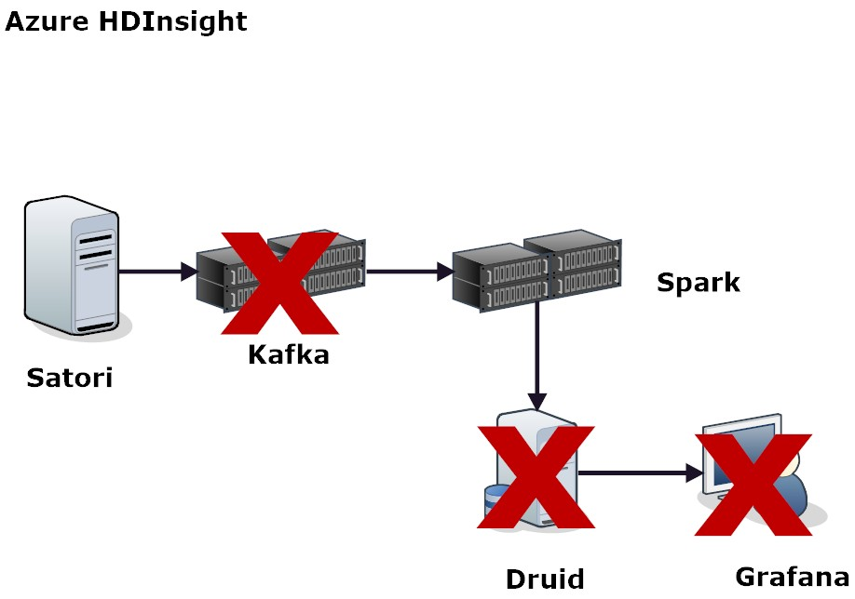
The New Plan

Slide 12
All Material Can Be Downloaded from GitHub
MassStreetAnalytics/iot-with-satori

Slide 13
Azure HDInsight
Button push Hadoop cluster
Cloud version of Hortonworks Data Platform
You can spin up different types of clusters
Plain Hadoop
Spark
Hbase
R Server
Storm
Real Time Hive
Kafka

Slide 14
Azure HDInsight
Each cluster type comes with the following
Ambari
Avro
Hive and Hcat
Mahout
MapReduce
Oozie
Phoenix (?) (I don’t normally play with Hbase)
Pig
Sqoop
Tez
Yarn
ZooKeeper

Slide 15
Azure HDInsight
Let’s stand up a cluster!

Slide 16
Azure HDInsight
Make sure you blow away the resource group!

Slide 17
The Case for Learning IoT
IoT represents a significant business opportunity
Still on the wrong side of the hype cycle
Not sure why
Might be due to hardware requirements
Just a matter of time
IoT opens up an new world of applications
IoT use cases
Has the potential for ubiquitousness

Slide 18

An IoT Case Study Life Alert
Fatal flaw (no pun intended) .
Patient has to be conscious to activate.

Slide 19
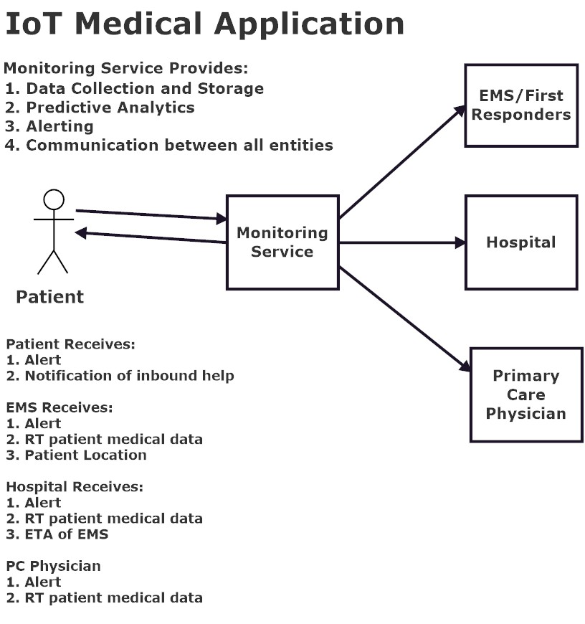
An IoT Case Study
Software is easy.
Challenge: Creating a device with a form factor that provides function but doesn’t get in the way of the patients life.

Slide 20
Satori
www.satori.com
Open Streaming Data Platform
Appears to be in tech preview
So far appears to be free on the sub side
Allows people to pub/sub to data streams
A lot of municipal and science streams
Not just IoT data

Slide 21
Satori
You need an SDK to build stuff with Satori
You can use your favorite build tool to import the necessary classes

Slide 22
Satori
Let’s look at some code!

Slide 23

Spark Structured Streaming….

Slide 24
import org.apache.spark.sql.functions._
import org.apache.spark.sql.SparkSession
val spark = SparkSession.builder.appName("StructuredNetworkWordCount").getOrCreate()
import spark.implicits._
// Create DataFrame representing the stream of input lines from connection to localhost:9999
val lines = spark.readStream.format("socket").option("host", "localhost").option("port", 9999).load()
// Split the lines into words
val words = lines.as[String].flatMap(_.split(" "))
// Generate running word count
val wordCounts = words.groupBy("value").count()
// Start running the query that prints the running counts to the console
val query = wordCounts.writeStream.outputMode("complete").format("console").start()
query.awaitTermination()

Slide 25
Spark Structured Streaming
Represents a VAST improvement over previous stream processing frameworks
Storm
Flume
Flink
Samza
Spark Streaming
Allows you to create stream processes without having to think much about it.

Slide 26
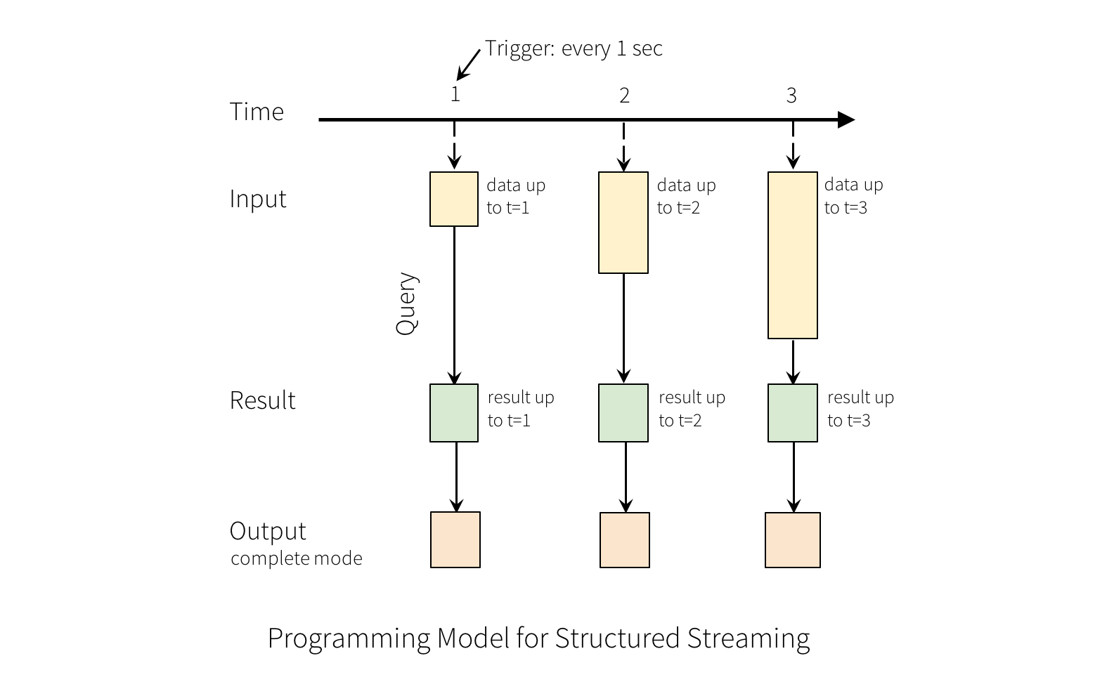
Spark Structured Streaming

Slide 27
Spark Structured Streaming
If you can make batch jobs with Spark SQL, you can make Structured Streaming Jobs.
So new there is little to no literature on the topic.
Structured Streaming Programming Guide is your best bet.
Exactly once delivery semantics out of the box.
Limited number of built in sources
Socket
Kafka
File

Slide 28
Spark Structured Streaming
Fairly unlimited on sinks
JSON
ORC
Parquet
CSV
Database table

Slide 29
Spark Structured Streaming
Things you can do with Structured Streaming
SQL Operations
Grouping/aggregations
Filtering
Joins (one DF has to be static)
Things you can’t do make no sense in a streaming context
Limit
First N rows
Operations over sliding windows
Handling late data with watermarking

Slide 30
Spark Structured Streaming
Let’s look at some code!

Slide 31
Code Challenge
Convert the socket server into a Kafka Producer
Find a streaming source that’s simpler in structure than the weather data and use it
Attempt to parse the weather data and load it into a case class.
Try and build the rest of the application.

